Slide 1



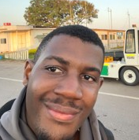
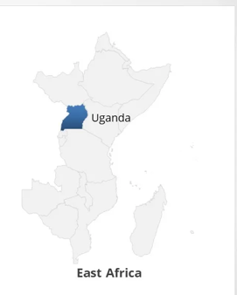


Daniel Mayombwe Banadda
University: Karlsruhe University of Applied Sciences
Study program: Electrical Engineering and Information Technology
Year of study: 1st Semester
City: Karlsruhe, Germany
Motto for life: One step at a time
Hobbies: Singing, cooking, listening to music swimming, participating in track and field events such as sprinting and relays
Your expectations from the summer school:
Learning and understanding sustainable systems as well as establishing international connections
Location where I live ↑,
Location of my origin ↓
Karlsruhe
31 August to 11 September 2026

